Slide 1














Water Quality Monitoring
Kratika Nigam & Rishika

Slide 2

INTRODUCTION
What is water monitoring System?
Importance of Water Quality Monitoring.
Challenges with Previous Work.
Solving Challenges with IoT.

Slide 3
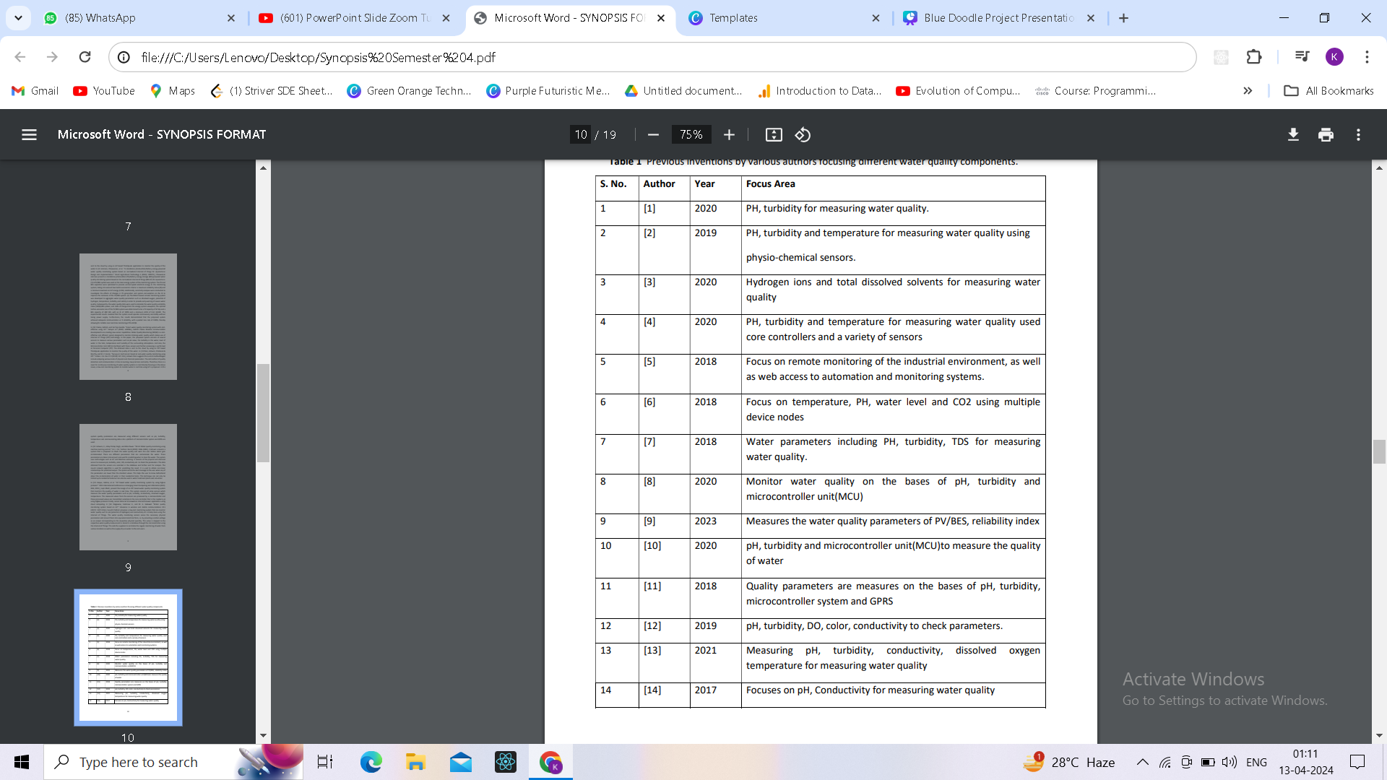
Literature Survey

Slide 4







Identification of key challenges in water quality monitoring near human settlements.
Implementation of a toxicity detection algorithm to promptly alert authorities of water contamination or pollution
Objectives
of
Research
Development of an improved architecture for water quality monitoring systems tailored for areas near towns, villages, and cities.
Deployment of sensors in water bodies such as ponds and rivers to collect real-time data on key parameters
Integration of IoT-based techniques for real-time data collection and transmission.
Collaboration with stakeholders including local authorities, communities, and environmental organizations to ensure the sustainability and scalability of the project.

Slide 5
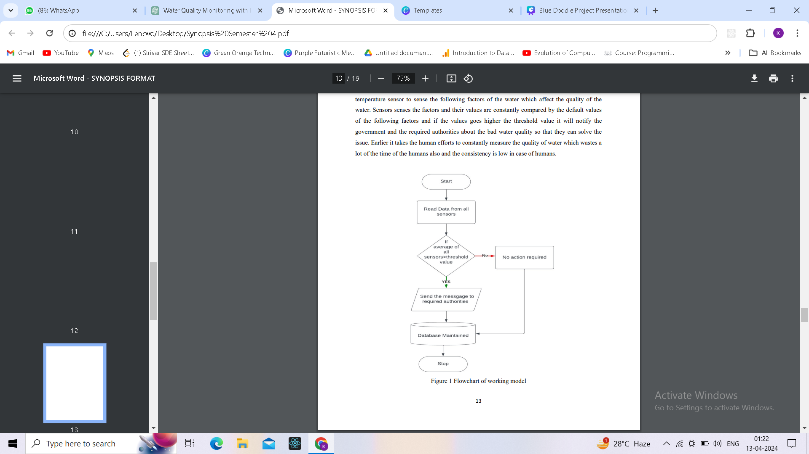

Research Methodology

Slide 6
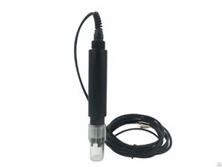
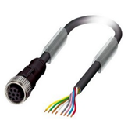
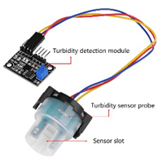
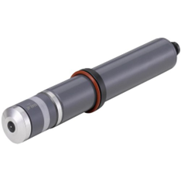
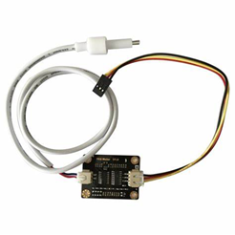
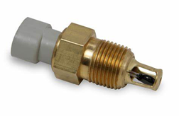
Sensors
PH Sensor
Lead Sensor
Turbidity Sensor
Chlorine Sensor
TDS Sensor
Temperature Sensor

Slide 7
Proposed Improved Architecture
01.
Research Outcome
02.
Enhanced Toxicity Detection:
03.
Improved Decision-Making

Slide 8
References
1: Yasin, S. N. T. M., Mohd Fauzi Mohd Yunus, and Nur Bahiyah Abdul Wahab. "The development of water quality monitoring system using internet of things." J. Educ. Learn. Stud 3 (2020): 14.
2: Sengupta, Bharati, et al. "Water quality monitoring using IoT." Int. Res. J. Eng. Technol. 6 (2019): 695-701
3: Vergina, S. Angel, et al. "A real time water quality monitoring using machine learning algorithm." Eur. J. Mol. Clin. Med 7 (2020): 2035-2041.
4: Chaudhari, Neha, et al. "Water Monitoring System-IoT." (2020).
5: Punpale, Abhijeet S., and P. B. Borole. "Water quality monitoring and control using IoT and industrial automation." IJSTE 4.12 (2018): 133-238.
6: Madhavireddy, Vennam, and Bonagiri Koteswarrao. "Smart water quality monitoring system using IoT technology." Int. J. Eng. Technol 7.4.36 (2018): 636. 7: Gowthamy, J. C. R. R., et al. "Smart water
monitoring system using IoT." International Research Journal of Engineering and Technology 5.10 (2018): 1170-1173.

Slide 9
8: Pasika, Sathish, and Sai Teja Gandla. "Smart water quality monitoring system with cost-effective using IoT." Heliyon 6.7 (2020): e04096.
9: Jamroen, Chaowanan, et al. "A standalone photovoltaic/battery energy-powered water quality monitoring system based on narrowband internet of things for aquaculture: Design and implementation." Smart Agricultural Technology 3 (2023): 100072.
10: Pasika, Sathish, and Sai Teja Gandla. "Smart water quality monitoring system with cost-effective using IoT." Heliyon 6.7 (2020): e04096
11:Doni, Ashwini, Chidananda Murthy, and M. Z. Kurian. "Survey on multi sensor based air and water quality monitoring using IOT." Indian J. Sci. Res 17.2 (2018): 147-153.
12: Ashwini, C., Uday Pratap Singh, and Ekta Pawar. "Shristi Water quality monitoring using machine learning and iot." Int. J. Sci. Technol. Res 8 (2019): 1046-1048.
13: Haque, Halima, et al. "IoT based water quality monitoring system by using Zigbee protocol." 2021 International Conference on Emerging Smart Computing and Informatics (ESCI). IEEE, 2021.
14: Daigavane, Vaishnavi V., and M. A. Gaikwad. "Water quality monitoring system based on IoT." Advances in wireless and mobile communications 10.5 (2017): 1107-1116.

Slide 10
Thank you very much!
Kratika Nigam

